Slide 1
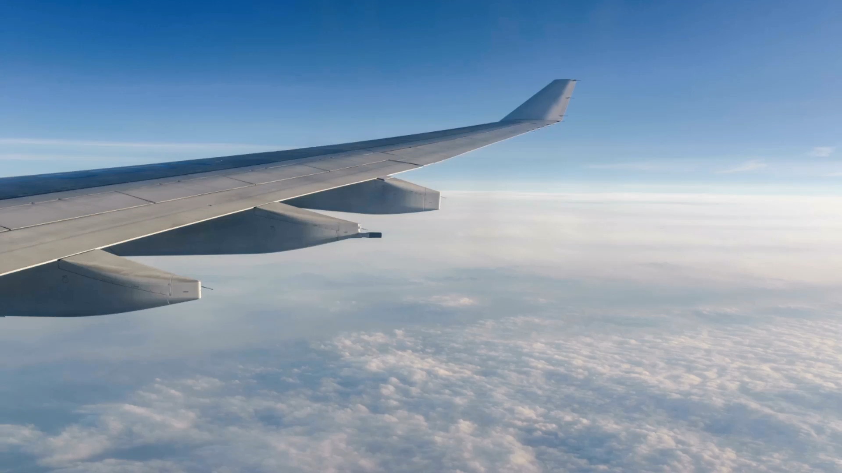
British Airways Customer Review Analysis
Data-Driven Insights and Recommendations
July 2025

Slide 2
Project Overview & Methodology
Objective: Analyze British Airways customer reviews to extract insights.
• Web scraping: 3,949 reviews from AirlineQuality.com
• Data cleaning: Missing values handled, feature engineering done
• Sentiment analysis using VADER
• TF-IDF vectorization and keyword insights
• Random Forest model used for classification (95% accuracy)

Slide 3
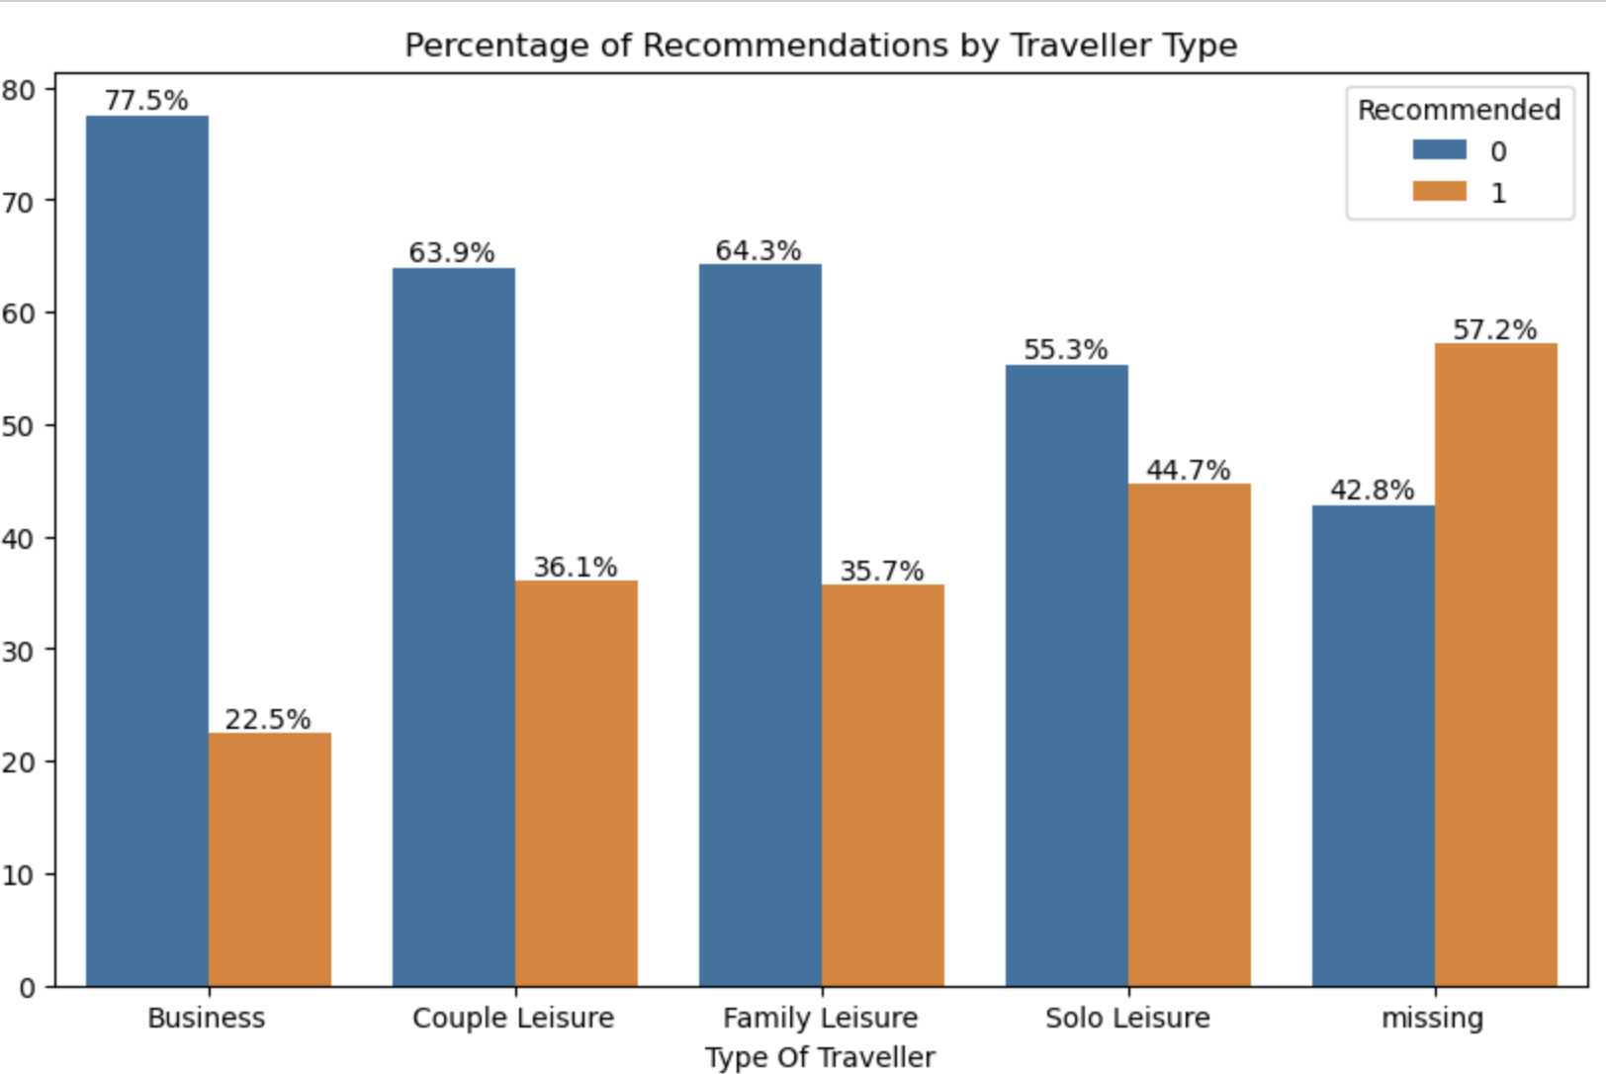
Key Insights from EDA & Sentiment
Traveler Recommendation:
78% of business travellers did not recommend BA
64% of economy travellers did not recommend BA
Solo leisure travellers were more balanced (55% no, 45% yes)

Slide 4
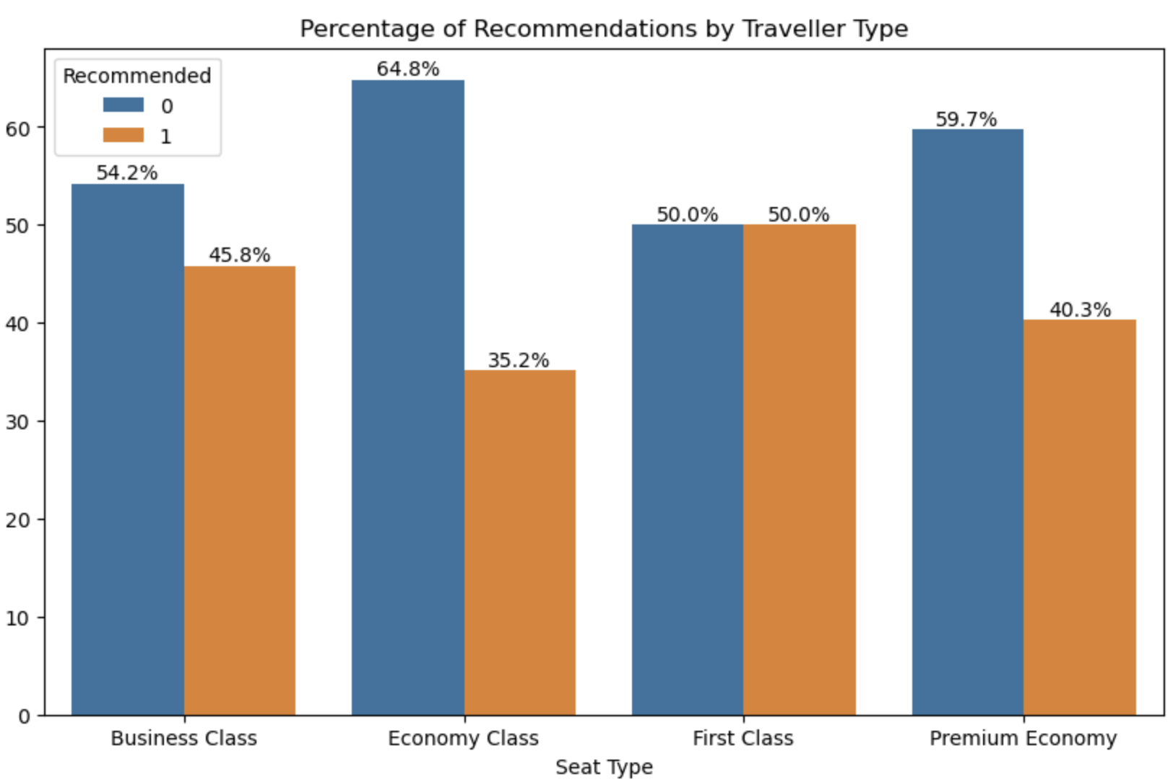
Recommendation by seat types
Economy Class passengers are the least satisfied:
Only 35.2% recommend British Airways
A striking 64.8% do not recommend
Business Class also shows mixed feedback:
45.8% recommend, while 54.2% do not
Premium Economy sees low satisfaction as well:
59.7% gave a non-recommendation
First Class is the only seat type with balanced sentiment:
Exactly 50% recommend, 50% do not

Slide 5
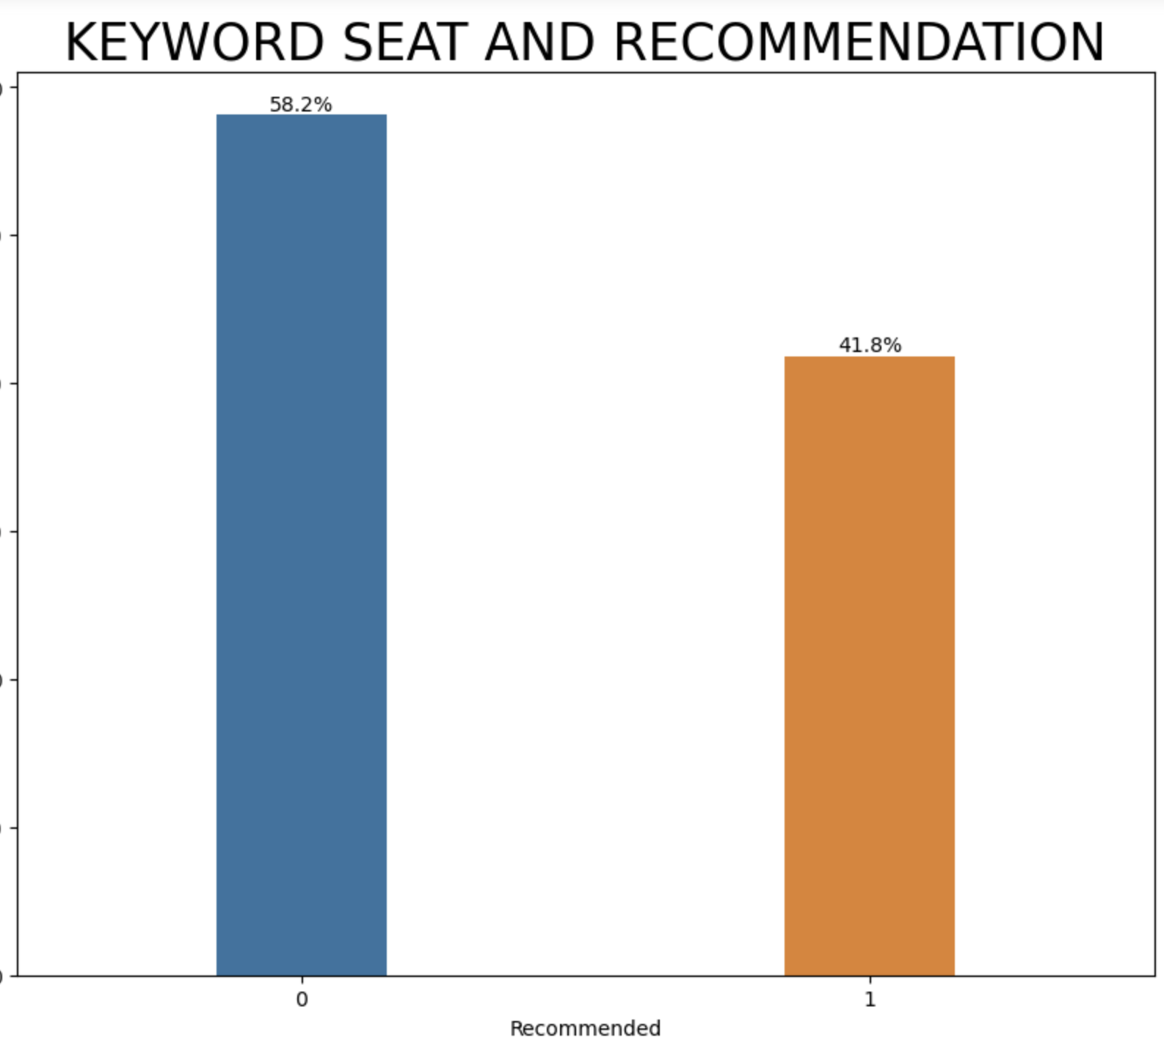
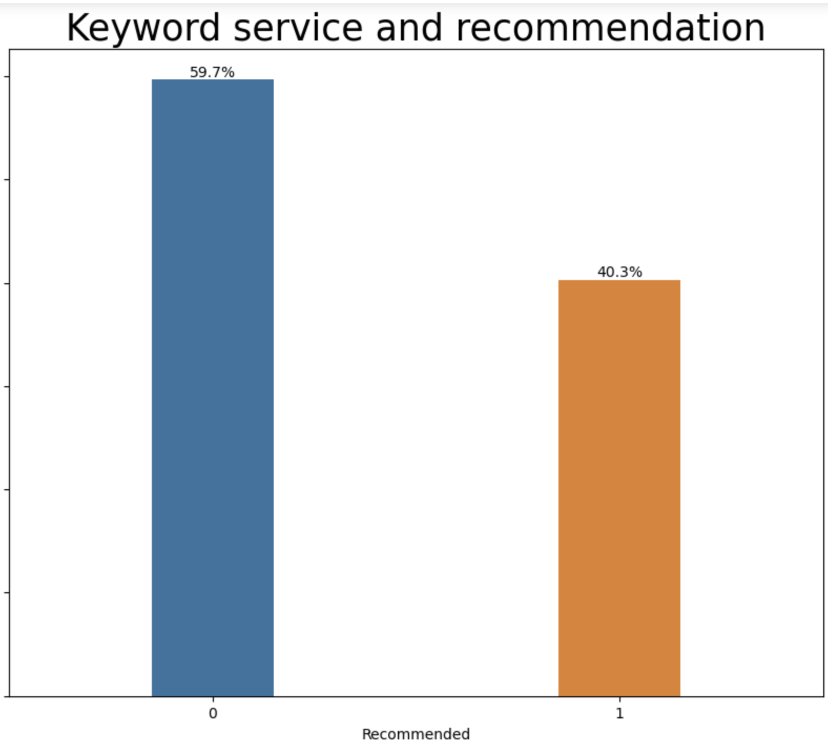
NLP + Modelling Insights
Text Features (TF-IDF):
Keywords like 'seat' and service' strongly linked to negative reviews
58% of reviews mentioning 'seat' were negative out of a total of 2134
reviews
60% of reviews mentioning ‘service' were negative out of a total of 1950
reviews that had service as a keyword

Slide 6
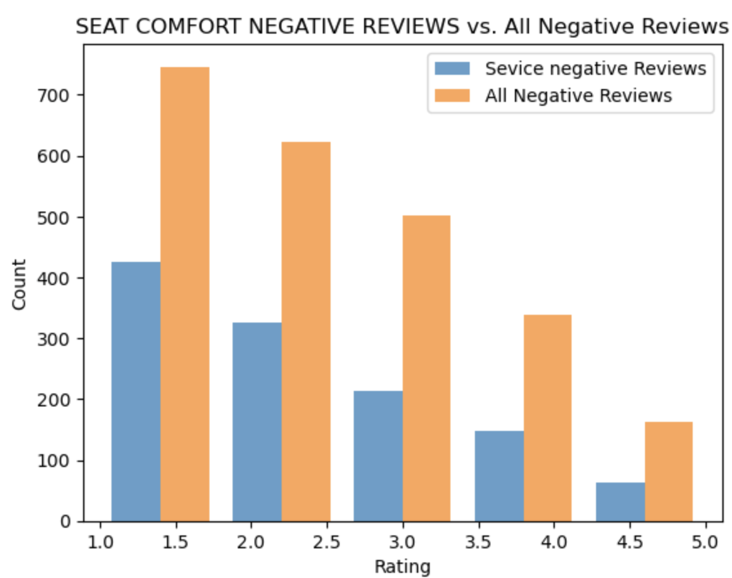
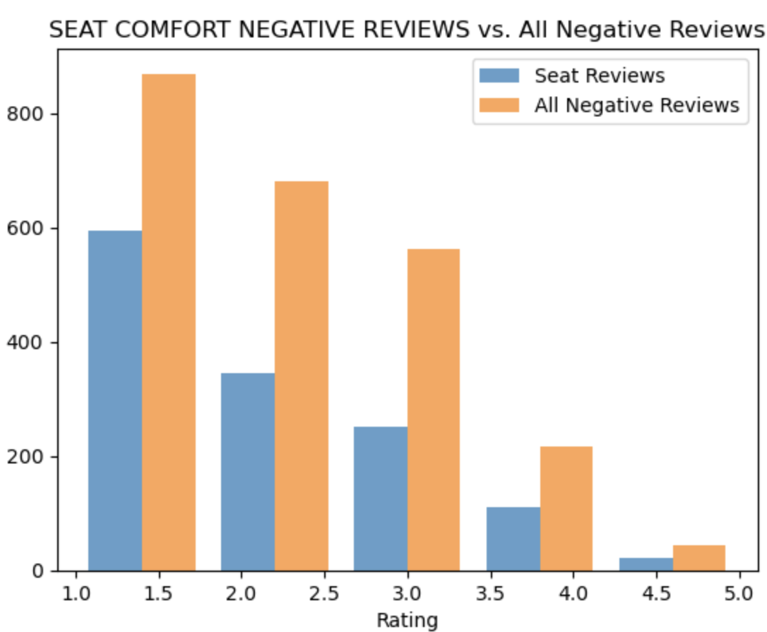
"Seat" Keyword vs. Seat Comfort Ratings
Reviews mentioning the word "seat" show a strong correlation with low seat comfort ratings (1–2 stars).
These reviews are significantly overrepresented in the lowest rating tiers compared to the general pool of negative reviews.
Suggests discomfort is a key driver of dissatisfaction when “seat” is mentioned.
"Service" Keyword vs. Cabin Service Ratings
Similarly, reviews with the keyword "service" are heavily skewed toward low cabin staff service ratings.
Over 60% of such reviews rated service between 1 and 2.
Indicates customer service issues are a critical pain point in overall passenger experience.

Slide 7

Recommendations to British Airways
Focus Areas for Improvement:
• Enhance Seat Comfort and Layout
• Train Cabin Staff for service consistency
• Upgrade Inflight Entertainment systems
• Use NLP tools to monitor real-time review trends
Strategic Implementation:
• Prioritize low-performing service areas
• Design feedback loops from NLP dashboards

